Slide 1
VEHICLE EMERGENCY SUPPORT SYSTEM
BY:
Anonyo Sanyal, Pratik Gon, Pijush Das, Sutirtha Kumar Guha
Global Conference on Artificial Intelligence and Application (GCAIA 2020)

Slide 2
AIM
An automated vehicle assistance system.
To be a part of an interconnected network.
Considered as node in the network.
Different clusters are formed based on the similarity features.
Request is processed and analyzed at the edge.
Support is categorized into three major category
Service station overhead would be minimized.

Slide 3

INTRODUCTION
High load on the service centres.
Lack of utilization of nearby resources.
Lack of automation and filtration of the problem.

Slide 4
INTRODUCTION
The idea of edge computing.
The problem is solved using nearby resources
Three phase solution.
More efficient system in terms of human resource utilization and energy consumption in terms of fuel
“A technology is impactful not only if it creates positive changes in it’s domain, but also beyond it’s domain”

Slide 5
Related Work
Edge computing is a variation of distributed computing. [E. Hamilton, 2018]
Multi directional research area are found by implementing edge computing[X. Tuven et. al, 2017]
Usage of edge computing to resolve scalability issues in IoT [X. Sun et. al, 2016]
Offline services at the edge of the internet for mobile devices is discussed [W. Hu et. al, 2016].
Different challenges such as high latency, low spectral efficiency etc. in cloud environment are handled [Y. AI et. al, 2018].
An ontology based driver assistance system [S. Kannan et. al, 2010].
Car assistance system for indicating wrong lane selection, safety distance maintenance[Y. Zhou et. al, 2014].
Different level and types of automated support for the driver in modern day road traffic scenario is proposed
[V. Kukkala et. al, 2018][K. Park et. al, 2019].

Slide 6
THE PROPOSED WORK

Slide 7
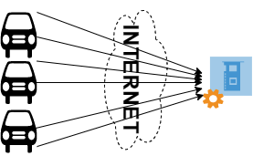
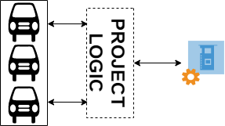
EDGE COMPUTING – In our Work
In conventional system all the data(problems) generated from numerous vehicle, are directly send to the Service-station to process which encounters high traffic load and very hard to serve all the cars if all the problems comes in same instance of time.
In our paper we introduce a model in between car and Service-station that can filter the problems at the edge of the data source to minimize the load upon network instead of relying on the Service-station to do all the work .

Slide 8
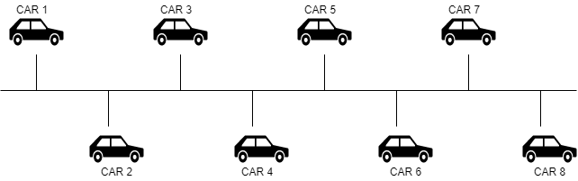
Filtering Process
In Phase 1 cars would be connected with each other using bus topology concept so that each car will be connected to each other as shown in figure .

Slide 9
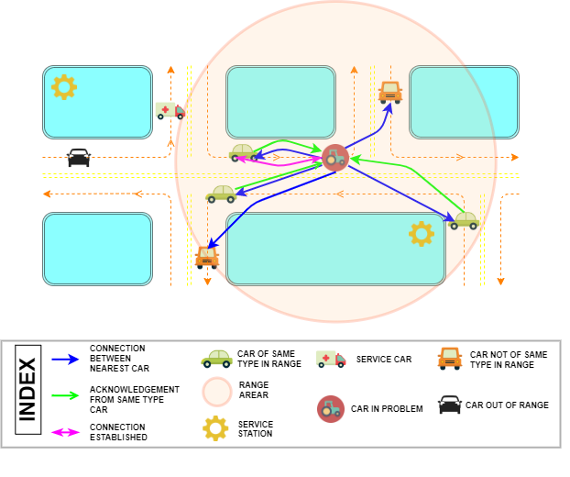
Filtering Process

Slide 10
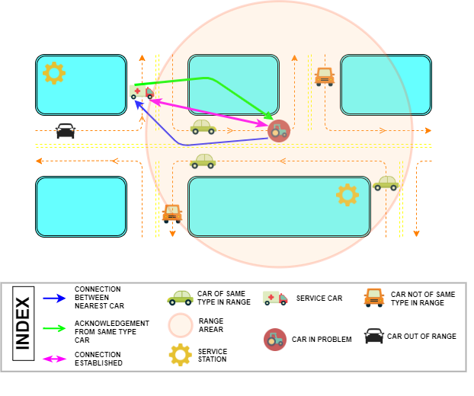
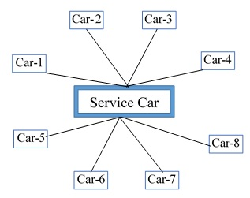
Filtering Process

Slide 11
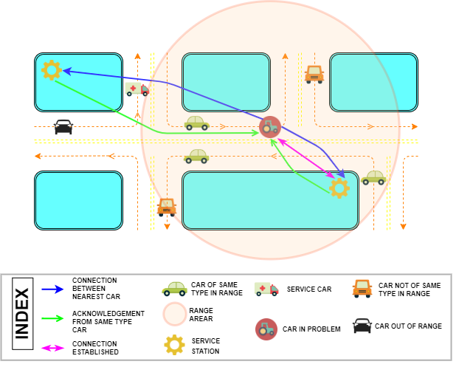
Filtering Process

Slide 12
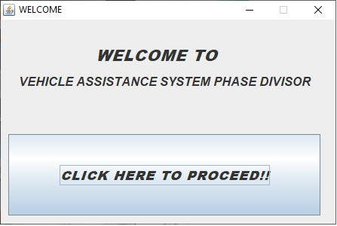
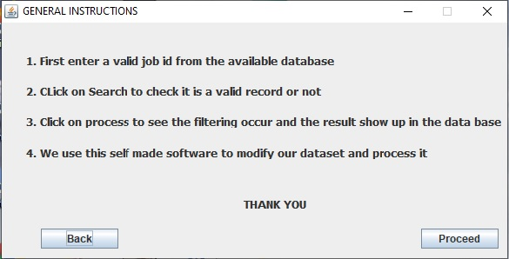
EXPERIMENTAL RESULT

Slide 13
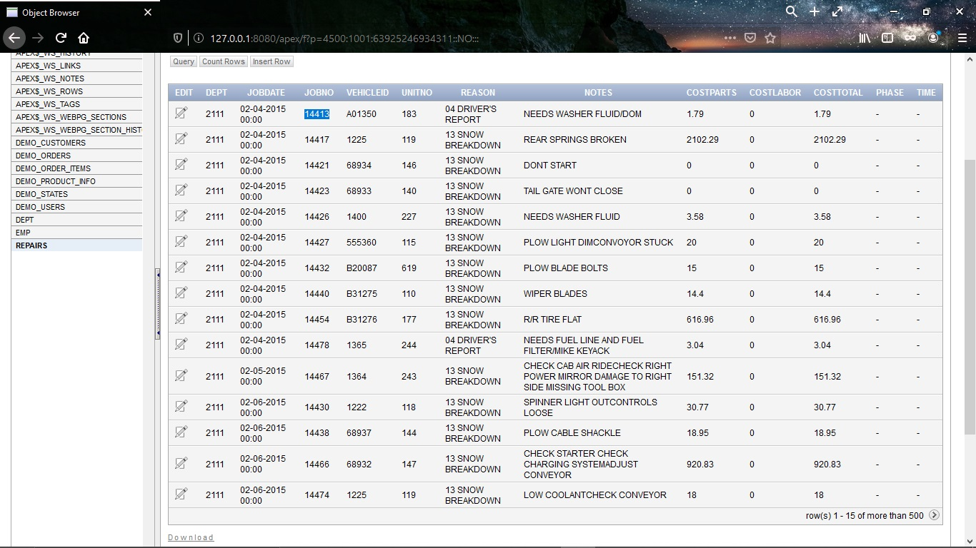
Dateset containing 618 Cases

Slide 14
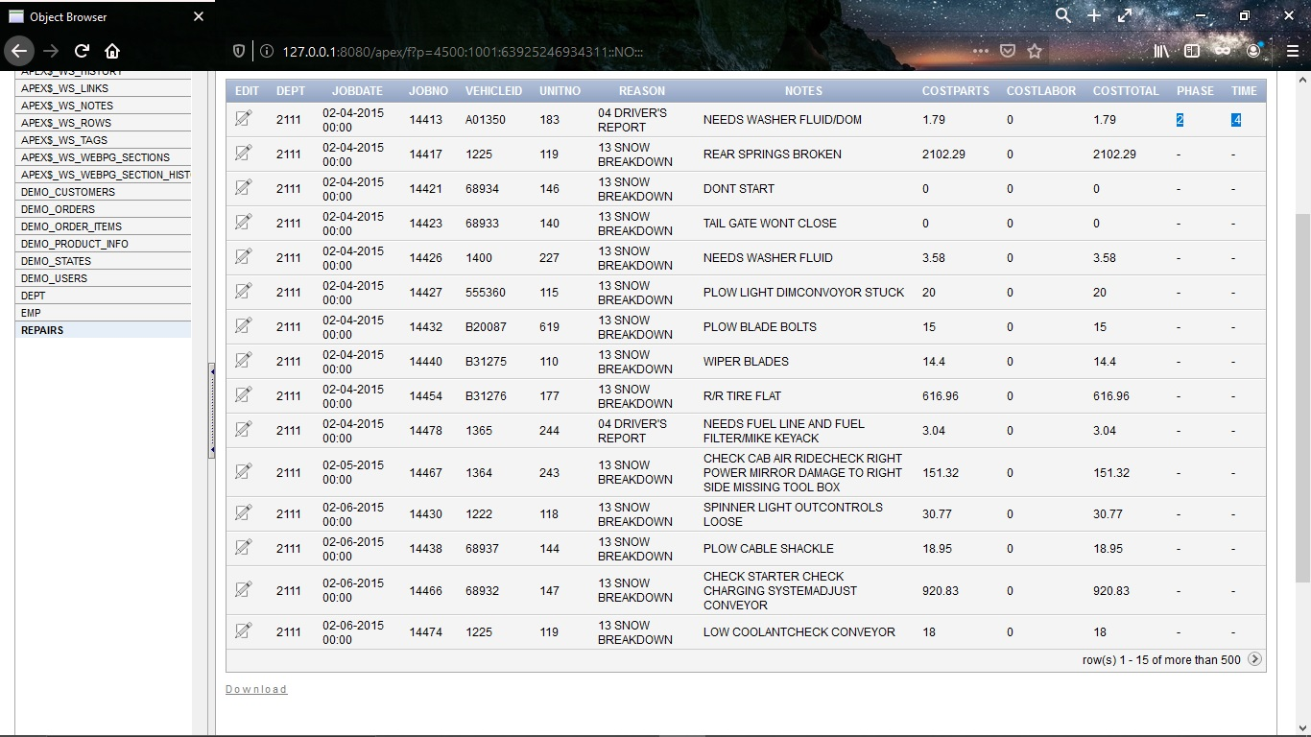
Implementing our proposed idea

Slide 15
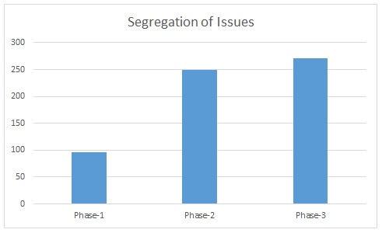
Case wise Segregation

Slide 16

ANALYSIS
Phase-1:
The no. of problems solved by fellow cars = $\left(\frac{p1}{100}\right)×f$
Phase-2:
The no. of problems solved by service cars = $\left(\frac{p2}{100}\right)× s$
Phase-3:
The no. of problems solved by service stations = $N−\left(\left(\frac{p1}{100}\right)×f\right)−\left(\left(\frac{p2}{100}\right)×s\right)$
In a typical system, No. of problem solved by the service station = N
The no. of car issues served by the service station by implementing our proposed method would be less as,
= $\left\{N− \left(N−\left(\left(\frac{p1}{100}\right)×f\right)−\left(\left(\frac{p2}{100}\right)×s\right)\right)\right\}$ = $\left(\left(\frac{p1}{100}\right)×f\right)+\left(\left(\frac{p2}{100}\right)×s\right)$

Slide 17

ANALYSIS
Fuel consumption is directly proportional to the distance travelled.
Phase-1
Distance travelled by fellow cars to provide assistance = $d_{1}=\left(\frac{f×p_{1}}{100}\right)×0=0$
Phase-2
Distance travelled by service cars to provide assistance = $d_{2}=\left(\frac{s×p_{2}}{100}\right)×d_{avg}$
Phase-3
Distance travelled to reach service station = $d_{3}=\left(N−\left(\frac{f×p_{1}}{100}\right)− \left(\frac{s×p_{2}}{100}\right)\right)×D_{avg}$
Total distance travelled= d_{edge} = d₁ + d₂ + d₃ = $\left(\frac{s×p_{2}}{100}\right)×d_{avg}+ \left(N−\left(\frac{f×p_{1}}{100}\right)− \left(\frac{s×p_{2}}{100}\right)\right)×D_{avg}$
In typical cases total distance travelled= d_{non-edge} = $N×D_{avg}$
$\left(Fuel Consumption ∝ Distance Covered\right)$.
d_{improved} = d_{non-edge} – d_{edge}
= $\left(N×D_{avg}\right)−\left(\left(\frac{s×p_{2}}{100}\right)×d_{avg}+ \left(N−\left(\frac{f×p_{1}}{100}\right)− \left(\frac{s×p_{2}}{100}\right)\right)×D_{avg} \right)$
= $\left(\left(\frac{f×p_{1}}{100}\right)+\left(\frac{s×p_{2}}{100}\right)\right)×D_{avg} −\left(\frac{s×p_{2}}{100}\right)×d_{avg}$

Slide 18
CONCLUSION
The expenditure in terms of human resource and fuel consumption would be reduced.
More than 50% issues would be resolved by the fellow vehicles or service cars.
Advantageous over the typical system that need the entire issues at service station and then analyze and decide centrally.
Great help in case of autonomous vehicle systems.in case they need assistance
In case of mass failure of autonomous cars, the servers will have a lot of pressure on itself. Then edge computing comes to the rescue.
The time taken is considerably less
The entire process faster by implementing Edge Computing concept

Slide 19

FUTURE SCOPE
Automated requirement and remedial measure selection.
Agent based selection of available services.

Slide 20
REFERENCES
[1] Eric Hamilton, “What is Edge Computing: The Network Edge Explained”, cloudwards.net, 2018.
[2] Tuyen X. Tran, Mohammad-Parsa Hosseini, Dario Pompili, “Mobile Edge Computing: Recent Efforts and Five Key Research Directions”, IEEE COMSOC Communications-Frontiers, Volume 12, Issue 4, pp. 29-33, 2017
[3] Xiang Sun, Nirwan Ansari, “EdgeIoT: Mobile Edge Computing for the Internet of Things”, IEEE Communications Magazine, Volume 54, Issue 12, pp. 22-29, 2016.
[4] Wenlu Hu, Ying Gao, Kiryong Ha, Junjue Wang, Brandon Amos Zhuo Chen, Padmanabhan Pillai, Mahadev Satyanarayanan, “Quantifying the Impact of Edge Computing on Mobile Applications”, APSys’16, Hong Kong, 2016.
[5] Yuan Ai, Mugen Peng, Kecheng Zhang, “Edge computing technologies for Internet of Things: a primer”, Digital Communications and Networks, ScienceDirect, Volume 4, Issue 2, pp. 77-86, 2018.
[6] Saravanan Kannan, Arunkumar Thangavelu, RameshBabu Kalivaradhan, “An Intelligent Driver Assistance System (I- DAS) for Vehicle Safety Modelling using Ontology Approach”, International Journal of UbiComp, Volume 1, Issue 3, pp.15-29, 2010
[7] Yimin Zhou, Gang Wang, Guoqing Xu, Guoqiang Fu, “Safety driving assistance system design in intelligent vehicle”, IEEE International Conference on Robotics and Biomimetrics (ROBIO 2014), Bali, Indonesia, 2014
[8] Vipin Kumar Kukkala, Jordan Tunnell, Sudeep Pasricha, Thomas H Bradley, “Advanced Driver-Assistance System: A Path Toward Autonomous Vehicles”, IEEE Consumer Electronics Magazine, Volume 7, Issue 5, pp. 18-25, 2018.
[9] Kyudong Park, Jiyoung Kwahk, Sung H. Han, Minseok Song, Dong Gu Choi, Hyeji Jang, Dohyeon Kim, Young Deok Won, In Sub Jeong, “Modelling the Intrusive Feelings of Advanced Driver Assistance Systems Based on Vehicle Activity Log Data: Case Study for the Lane Keeping Assistance System”, International Journal of Automotive Technology, Volume 20, pp. 455-463, 2019.

Slide 21
THANK YOU

